Slide 1
AADHAR HACKATHON 2021
TEAM NAME : ONE AND ZERO
TEAM REF ID : Plp0ae0I3p

Slide 2
ADDRESS UPDATE CHALLENGE IN URBAN AREA
Tech/Framework used
JavaScript
Node.js
Express.js
EJS
VID wrapper API
Offline EKYC API
Opencage API (Geo code)

Slide 3
NODE MODULE USED
Compression
Cookie-parser
Cors
ejs
Express
Express-mongo-sanitize
Fast-tow-sms
Jsonwebtoken
Mongoose
Morgan
Unzipper
uuid
Xmll2js
xss-clean

Slide 4
USER ACCOUNT CREATED
USER
1->
2->
REQUEST SENT TO LANDLORD
3->
YES
LANDLORD GIVES RESPONSE TO THE REQUEST
NO
4->
GETS ADDRESS
REJECTED
MODIFIES ADDRESS
5->
ADDRESS CHECKED WITH GEO APP
NOT VERIFIED
6->
REJECTED
7->

Slide 5
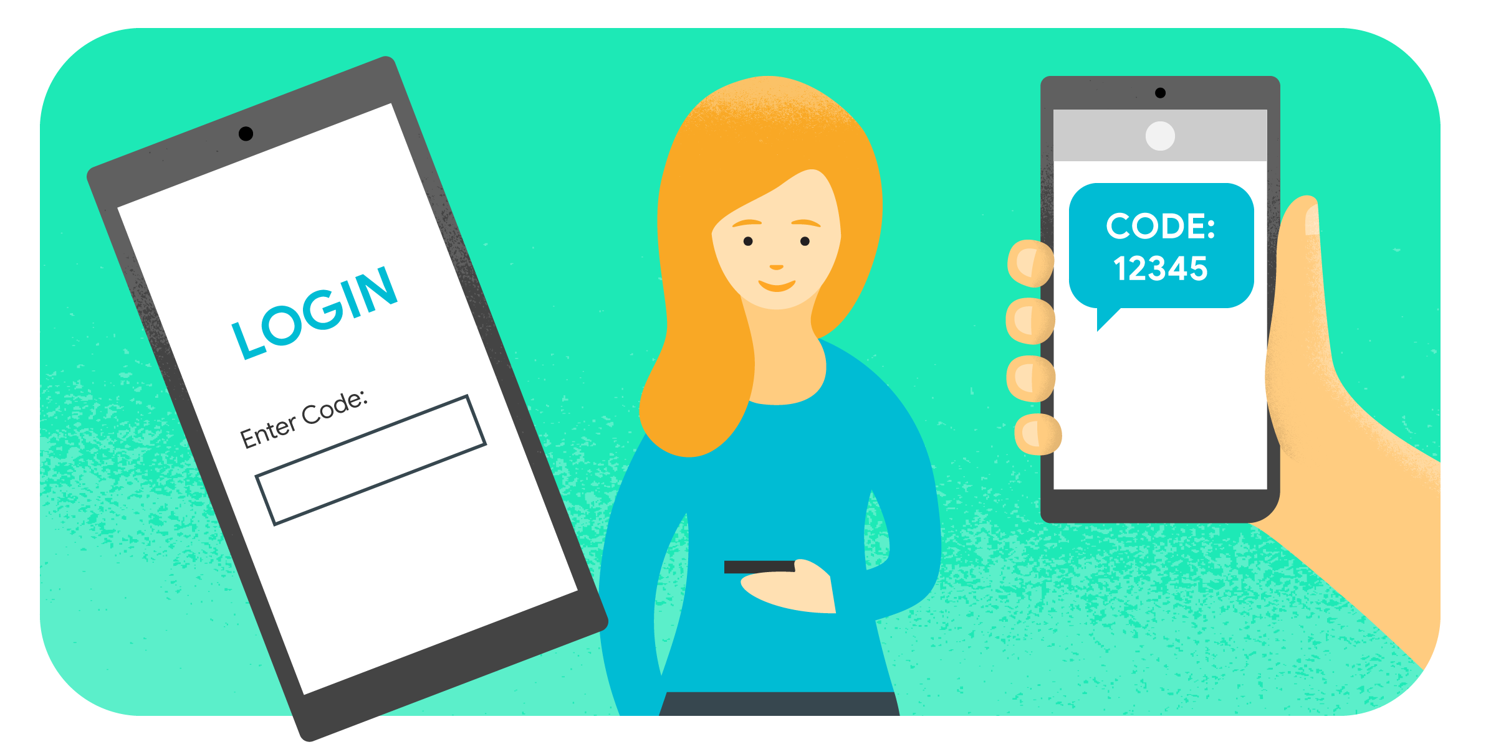
->)User will login to AADHAR Portal gives his UID number to client side, user will get OTP to his/her registered mobile number with help of VID wrapper API .
Account will be made on AADHAR database in name of user

Slide 6
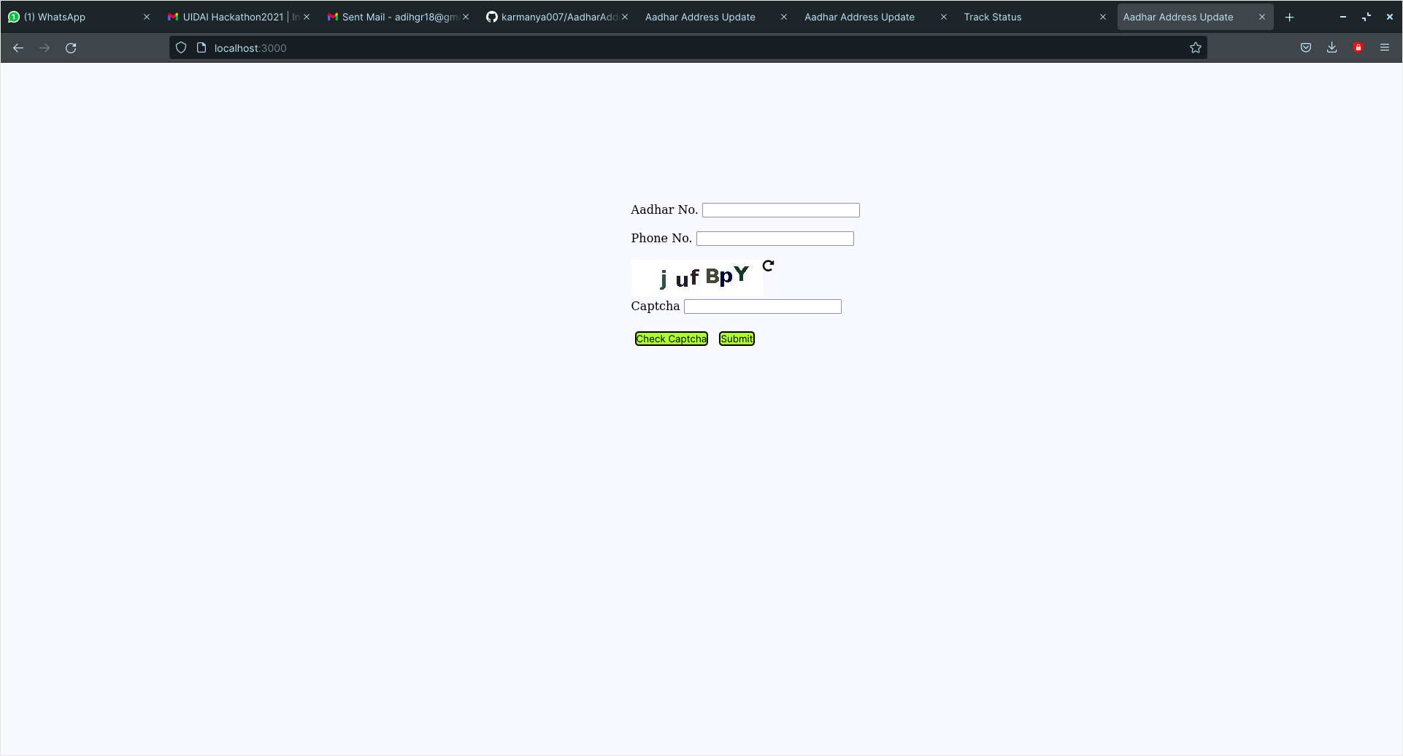

Slide 7
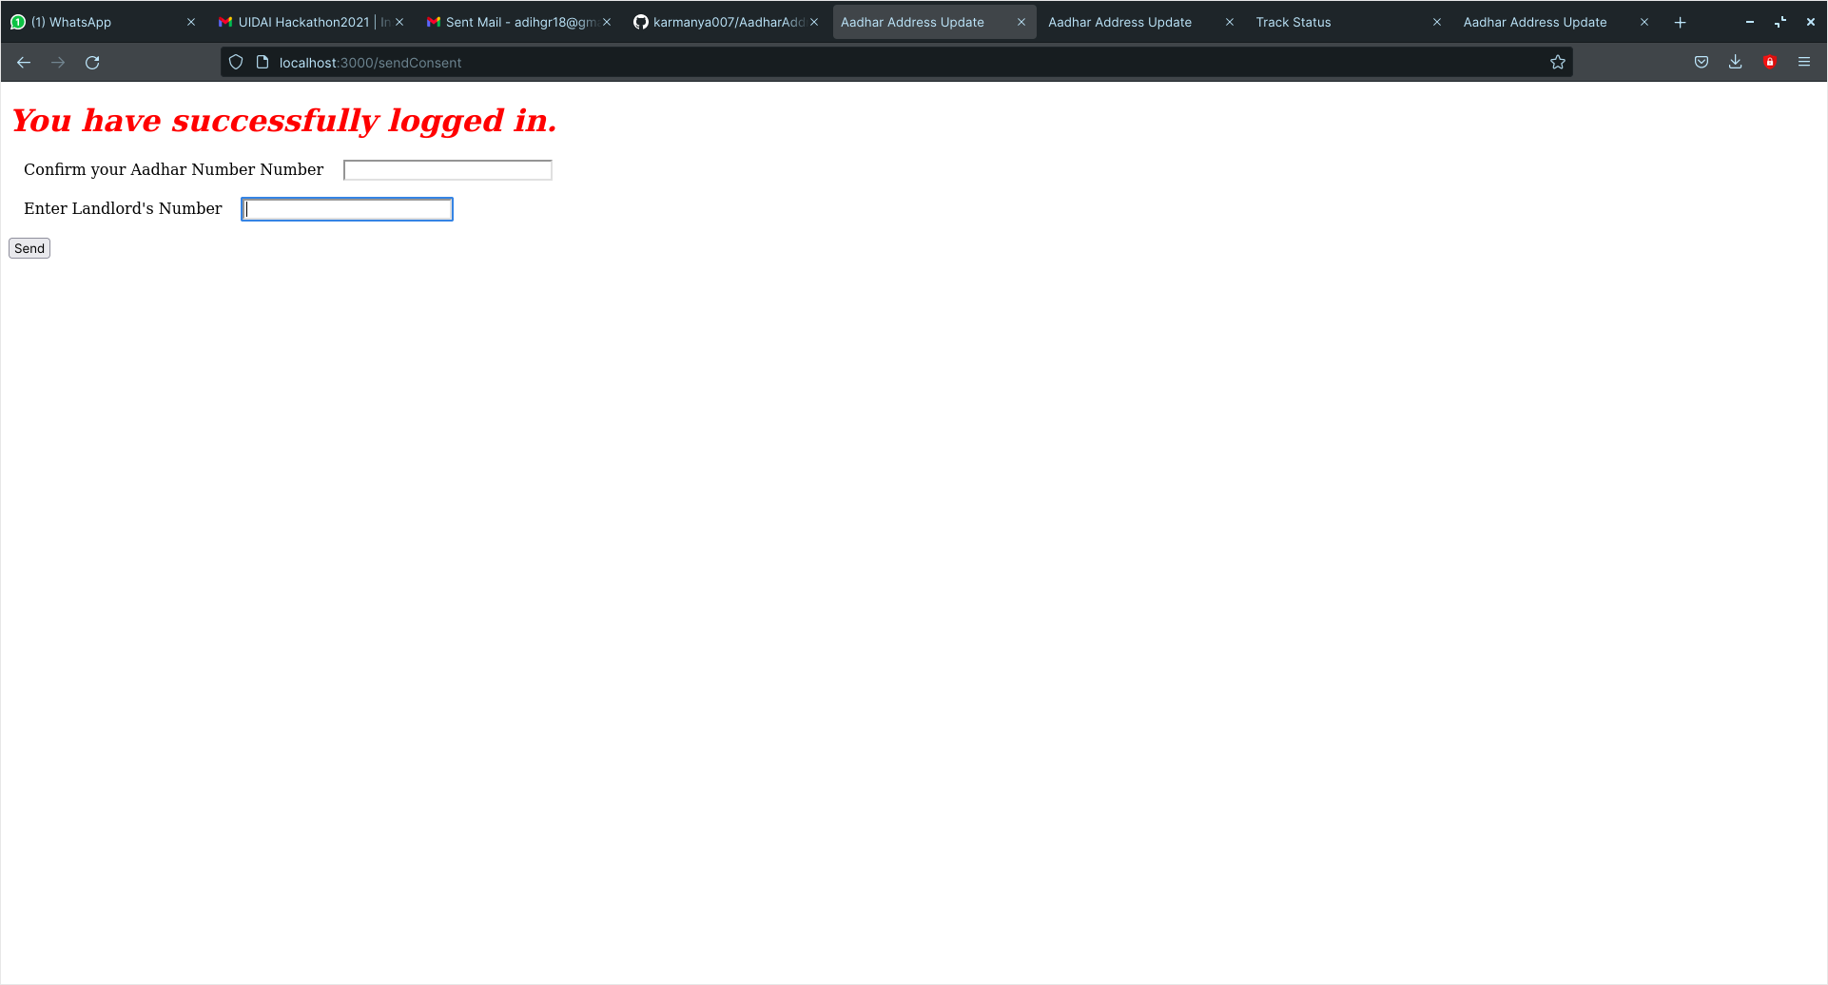
->)User will be redirected new page , here user will give the mobile number of the landlord for requesting to use his address for updating on his Aadhar card .

Slide 8
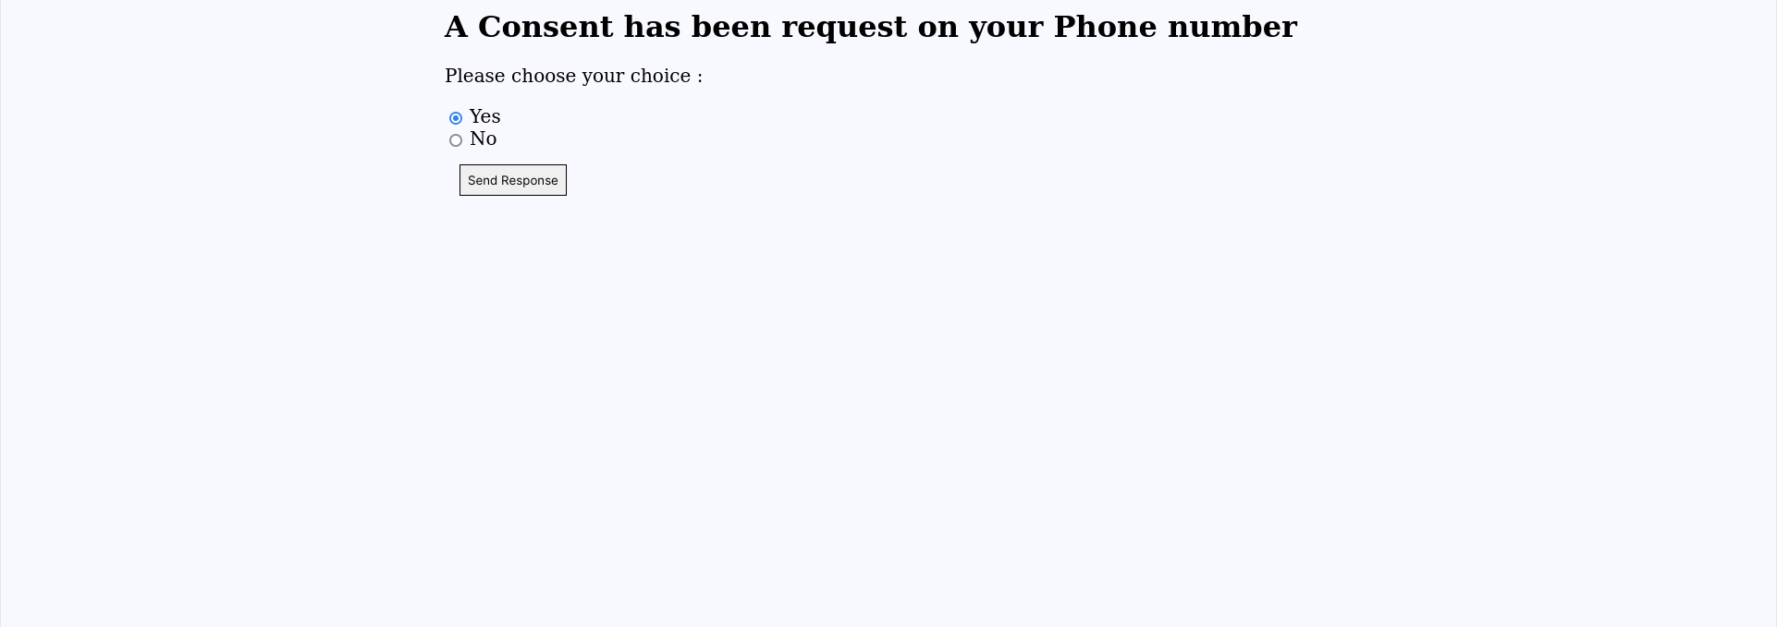
->)An message will be sent to the landlord for address request via SMS, landlord will open the link to login portal with his UID number . He will be given option to either accept or reject the request. If request is rejected then address update process will be terminated. else address or landlord will be given to the user with help of eKYC API. User can track his/her request status

Slide 9
->)After that user will be given option to give minor changes to the address ,after that it will be verified with and location app/API for comparison between old and modified address , if address is same then address will be given to the user and data will be stored in UID Database , else whole application process will be rejected .

Slide 10
